Slide 1
Programming Study electron
Sungwoo Nam
2018.2.28

Slide 2
Electron
Develop desktop application using javascript, HTML, CSS.
Runs on Windows, Linux, Mac
Based on Chrome

Slide 3
Develop environment
Install Node.js
Install VSCode
PS D:\depo\et> git clone https://github.com/SungwooNam/equipment-boilerplate.git ecb
Cloning into 'ecb'...
...
Resolving deltas: 100% (67/67), done.
PS D:\depo\et> cd ecb
PS D:\depo\et\ecb> npm install
> electron-chromedriver@1.8.0 install D:\depo\et\ecb\node_modules\electron-chromedriver
> node ./download-chromedriver.js
successfully dowloaded and extracted!
> electron@1.8.2 postinstall D:\depo\et\ecb\node_modules\electron
> node install.js
added 442 packages in 27.565s
PS D:\depo\et\ecb> npm run start

Slide 4
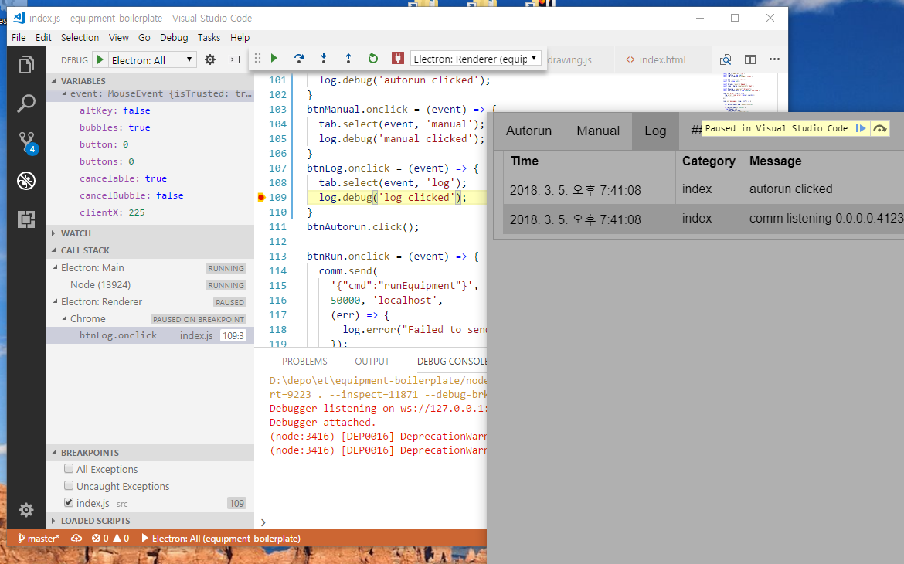
Debugging
./.vscode/launch.json
F9 breakpoint, F5 run

Slide 5
Electron Main - Renderer
<!-– index.html-->
<!DOCTYPE html>
<html> <head>
…
<link href="css/styles.css" type="text/css" rel="stylesheet" />
</head> <body>
… <script>require('./index.js')</script>
</body> </html>
// main.js
const electron = require('electron')
const app = electron.app
const path = require('path')
const url = require('url')
let mainWindow
function createWindow() {
mainWindow = new electron.BrowserWindow({
width: 800,
height: 600,
frame: false
})
mainWindow.loadURL(url.format({
pathname: path.join(__dirname, 'index.html'),
protocol: 'file:',
slashes: true
}))
... }
app.on('ready', createWindow)
body {
font-family: Arial;
}
…
// index.js
const dgram = require('dgram');
const comm = dgram.createSocket('udp4');
comm.on('message', (msg, rinfo) => {
var packetType = msg.readUInt32LE(0);
…

Slide 6
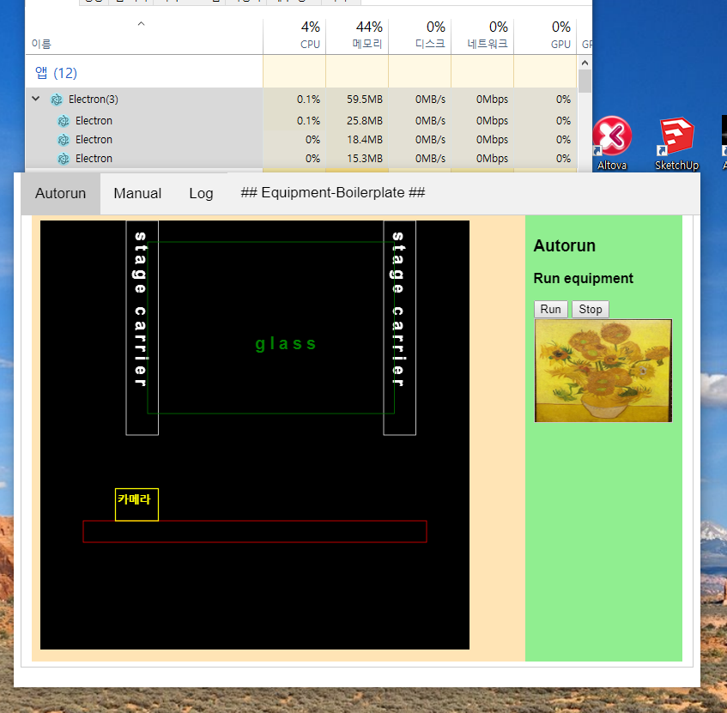
Electron Main - Renderer

Slide 7
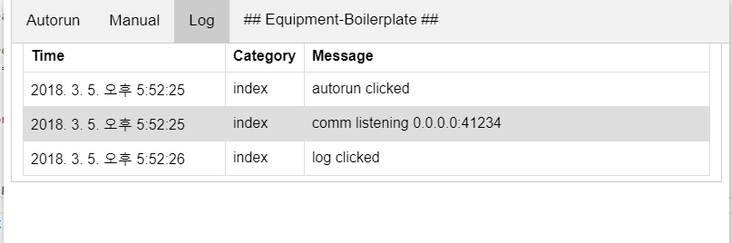
Log usage
const Log = require("./log")
const logView = new Log();
const log = logView.getLogger("index");
const comm = dgram.createSocket('udp4');
comm.on('error', (err) => {
log.error(`comm error:\n${err.stack}`);
});
comm.on('message', (msg, rinfo) => {
… log.info(`comm got: ${msg} from ${rinfo.address} : ${rinfo.port}`);
});
comm.on('listening', () => {
const address = comm.address();
log.info(`comm listening ${address.address} : ${address.port}`);
});
comm.bind(41234);
btnAutorun.onclick = (event) => {
tab.select(event, 'autorun');
log.debug('autorun clicked');
}
...
[2018-03-03T01:10:44.488] [INFO] index - comm listening 0.0.0.0:41234
[2018-03-03T01:10:46.370] [DEBUG] index - log clicked
[2018-03-03T01:19:16.796] [DEBUG] index - autorun clicked
...
[2018-03-05T14:21:27.780] [ERROR] index - Cannot support image with 160x120x32
...

Slide 8
Log using log4js
// log.js
var log4js = require('log4js');
class Log {
constructor() {
…
log4js.configure('./config/log4js.json');
}
getLogger( category ) {
return log4js.getLogger( category );
}
…
module.exports = Log;
{
"appenders": {
"app": {
"type": "file",
"filename": "log/app.log",
"maxLogSize": 10485760,
"numBackups": 3
},
"errorFile": {
"type": "file",
"filename": "log/errors.log"
},
"errors": {
"type": "logLevelFilter",
"level": "ERROR",
"appender": "errorFile"
}
},
"categories": {
"default": {
"appenders": [
"app",
"errors"
],
"level": "DEBUG"
}
}
...
[2018-03-03T01:10:44.488] [INFO] index - comm listening 0.0.0.0:41234
[2018-03-03T01:10:46.370] [DEBUG] index - log clicked
[2018-03-03T01:19:16.796] [DEBUG] index - autorun clicked
...
[2018-03-05T14:21:27.780] [ERROR] index - Cannot support image with 160x120x32
...

Slide 9
Log – display using table
log4js.addLayout('showImmediate', function (config) {
return ( log ) => {
var table = document.getElementById("logTable");
if (table != null) {
var row = document.createElement("tr");
row.innerHTML =
`<td>${log.startTime.toLocaleString()}</td>
<td>${log.categoryName}</td>
<td>${log.data}</td>`;
table.append(row);
}
}
});
log4js.configure('./config/log4js.json');
{
"appenders": {
...
"out": {
"type": "stdout",
"layout": {
"type": "showImmediate"
}
...
<div id="log" class="tabcontent">
<table id="logTable">
<col width="30%">
<col width="10%">
<col width="60%">
<tr>
<th>Time</th>
<th>Category</th>
<th>Message</th>
</tr>
</table>
</div>

Slide 10
Tab – HTML & CSS
<div class="tab">
<button class="tablinks" id="btnAutorun">Autorun</button>
<button class="tablinks" id="btnManual">Manual</button>
<button class="tablinks" id="btnLog">Log</button>
<label class="tab remaining">## Equipment-Boilerplate ##</button>
</div>
<div id="autorun" class="tabcontent">
<div class="flex-container">
...
</div>
<div id="manual" class="tabcontent">
<div class="flex-container">
...
</div>
<div id="log" class="tabcontent">
<table id="logTable">
...
</div>
.tab button{
background-color: inherit;
...
}
.tab button:hover {
background-color: #ddd;
}
.tab button.active {
background-color: #ccc;
}
.tabcontent {
display: none;
...
}

Slide 11
Tab - javascript
class Tab {
constructor() {
this.content = document.getElementsByClassName("tabcontent");
this.links = document.getElementsByClassName("tablinks");
}
select(evt, tabId) {
for (var i = 0; i < this.content.length; i++) {
this.content[i].style.display = "none";
}
document.getElementById(tabId).style.display = "block";
for (var i = 0; i < this.links.length; i++) {
this.links[i].className = this.links[i].className.replace(" active", "");
}
evt.currentTarget.className += " active";
}
} module.exports = Tab;
const Tab = require('./tab');
const tab = new Tab();
btnAutorun.onclick = (event) => { tab.select(event, 'autorun');}
btnManual.onclick = (event) => { tab.select(event, 'manual'); }
btnLog.onclick = (event) => { tab.select(event, 'log'); }
btnAutorun.click();

Slide 12
Socket – receive UDP JSON
{
“cmd” : “ioUpdate”,
“address” : “768”,
“value” : [ “1”, “0”, “1”, “0”, “1”]
}
const dgram = require('dgram');
const comm = dgram.createSocket('udp4');
comm.on('message', (msg, rinfo) => {
var jm = JSON.parse(msg);
if (jm != null && jm.cmd == 'ioUpdate') {
if (jm.address == 0x300) {
var inport = document
.getElementById('ioIn')
.getElementsByTagName('input');
for (var i = 0; i < inport.length; ++i) {
inport[i].checked =
jm.value[i] == '1' ? true : false;
}
...
}
comm.bind(41234);
string IOUpdate2String(int addr, vector<int>& io )
{
Poco::JSON::Object j;
j.set("cmd", "ioUpdate");
j.set("address", addr);
Poco::JSON::Array v;
for (auto i : io) { v.add(i); }
j.set("value", v);
std::stringstream ss; j.stringify(ss);
return ss.str();
}
IDatagramPoint* p = ...
SocketAddress remote("127.0.0.1:41234");
string msg = IOUpdate2String(
0x300,
vector<int>{ 1, 0, 1, 0, 1 } );
point->SendTo(
msg.data(), (int)msg.size(),
remote);

Slide 13
Socket – send UDP JSON
{
“cmd” : “runEquipment”
}
const dgram = require('dgram');
const comm = dgram.createSocket('udp4');
comm.bind(41234);
btnRun.onclick = (event) => {
comm.send(
'{"cmd":"runEquipment"}',
50000, 'localhost',
(err) => {
log.error("Failed to send runEquipment");
});
}
IDatagramPoint::Ptr point =
m_Fab->CreateDatagramPoint(
SocketAddress("127.0.0.1:50000"),
[=](IDatagramPoint* p) mutable
{
char buffer[MAX_PATH];
SocketAddress sender;
int n = p->ReceiveFrom(
buffer, sizeof(buffer)-1, sender);
buffer[n] = '\0';
Poco::JSON::Parser parser
auto obj = parser.parse(buffer)
.extract<Poco::JSON::Object::Ptr>();
string cmd = obj->get("cmd").toString();
if (cmd == “runEquipment")
{
...

Slide 14
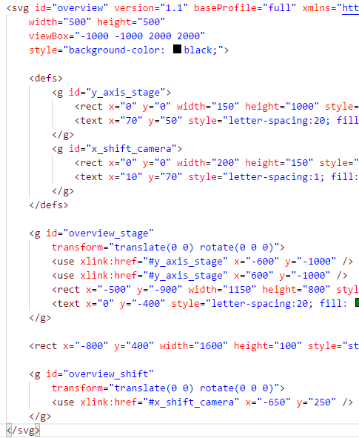
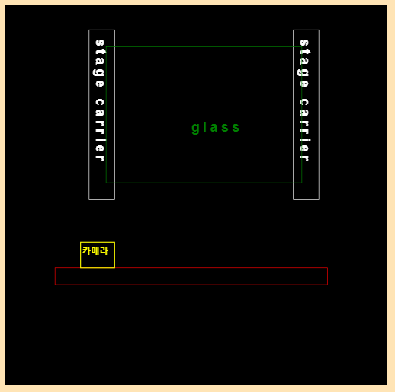
SVG - Graphic

Slide 15
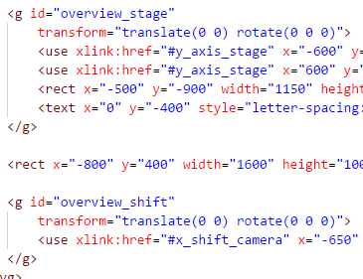
SVG – moving objects
comm.on('message', (msg, rinfo) => {
if (jm != null && jm.cmd == 'servoUpdate') {
var ypos = -parseInt(jm.value[0]);
var xpos = parseInt(jm.value[1]);
overview_stage.setAttribute(
"transform", `translate(0 ${ypos}) rotate(0 0 0)`);
overview_shift.setAttribute(
"transform", `translate(${xpos} 0 ) rotate(0 0 0)`);
return;
}

Slide 16
SVG – mouse movement
class Drawing {
constructor( idOfOverviewSVG ) {
this.id = idOfOverviewSVG;
this.svg = document.getElementById( idOfOverviewSVG );
var v = this.svg.getAttribute( "viewBox").split(" ");
this.view = {
x: parseInt(v[0]),
y: parseInt(v[1]),
width: parseInt(v[2]),
height: parseInt(v[3]),
}
this.mouseDown = 0; this.svg.onmousemove = (event) => { this.onMouseMove(event); }
...
}
onMouseMove( event )
{
if (this.mouseDown == 1) {
this.view.x += event.movementX;
this.view.y += event.movementY;
this.svg.setAttribute("viewBox",
`${this.view.x} ${this.view.y} ${this.view.width} ${this.view.height}`);
}
}

Slide 17
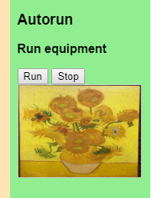
Canvas - Image
<article class="main">
<h3>Autorun</h3>
<p>Run equipment</p>
<button id="btnRun">Run</button>
<button id="btnStop">Stop</button>
<canvas
id="cameraImage"
width="160" height="120“
style="border: 1px solid #cccccc;"
/>
</article>
window.onload = function () {
initCameraImage();
}
function initCameraImage() {
var canvas = document.getElementById(
"cameraImage");
var context = canvas.getContext("2d");
var image = new Image();
image.src = "./sunflower.png";
image.onload = (arg) => {
context.drawImage(image, 0, 0);
};
}

Slide 18


Canvas – fragmented packet
struct ImageHeader {
uint32_t Type;
uint16_t Length;
uint16_t Width, Height, BPP;
uint16_t RegionX, RegionY, RegionWidth, RegionHeight;
};
vector< vector<uint8_t> > GenerateImagePacket(
const cv::Mat& m )
{
...
// make 64kbyte fragmented image packets
return packets;
}
auto packets = GenerateImagePacket(
CreateFilledImage(160, 120, (rand() | 0xFF000000)));
for (auto packet : packets) {
point->SendTo(packet.data(), (int)packet.size(), remote);
}

Slide 19
Canvas – parse binary packet
comm.on('message', (msg, rinfo) => {
var packetType = msg.readUInt32LE(0);
if (packetType == 0x6182) {
var header = {
type: packetType,
length: msg.readUInt16LE(4),
width: msg.readUInt16LE(6),
height: msg.readUInt16LE(8),
bpp: msg.readUInt16LE(10),
regionX: msg.readUInt16LE(12),
regionY: msg.readUInt16LE(14),
regionWidth: msg.readUInt16LE(16),
regionHeight: msg.readUInt16LE(18),
};
var canvas = document.getElementById("cameraImage");
var context = canvas.getContext("2d");
context.putImageData(
new ImageData(
new Uint8ClampedArray(msg.buffer, 20),
header.regionWidth, header.regionHeight
),
header.regionX, header.regionY,
0, 0, header.regionWidth, header.regionHeight
);

